Slide 1
SOEN 343
Week 3b. UML Sequence and activity diagrams

Slide 2
Learning objectives (1)
Learn how to enhance textual specifications with graphical representations based on UML sequence and activity diagrams
Understand which diagram type to use, and when
Understand the traceability challenges when working with diagramming techniques
Understand the concept of text-based modeling for UML diagrams
Learn how to map use case scenarios to sequence diagrams
Understand how to model conditional messages and repetitions

Slide 3
Learning objectives (2)
Learn the UML notation for activity diagrams
Learn the use of partitions (swim lanes) for structuring activity diagrams
Learn the connections between use cases and activity diagrams
Understand how to model parallel activities, branches, repetitions, sub-activities, signals, and guard conditions in activity diagrams
Learn guidelines for developing good activity diagrams

Slide 4
Learning objectives (3)
Understand the UML state machine diagram notation
Understand how to model states, events, transitions, and actions
Learn how to model systems with state machine diagrams
Understand how to identify relevant states and events
Learn how to structure diagrams with sequential and parallel decomposition
Learn how to map use cases toe state machines
Understand for what type of systems you should use state machine modeling
Learn some guidelines for quality assurance on state machines

Slide 5
UML Diagrams Applicable to SRS: Summary
UML diagrams appropriate for OO Analysis Modeling
Dynamic View:
System Sequence Diagram
Activity Diagram
State Machine Diagram
Static View:
Class Diagram for Domain Modeling
Domain Model
(static view)
Use Case Model
(dynamic view)
Notes:
Domain model may be considered a visual dictionary of the noteworthy abstractions, domain vocabulary and information content of the domain.

Slide 6
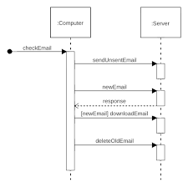
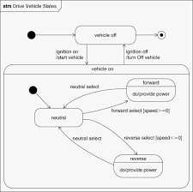
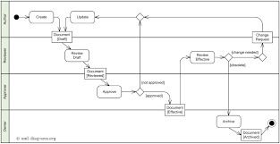
Modeling Behaviour
Sequence diagram
Activity diagram
State machine diagram
Notes:
We now look at additional methods for describing behavior
Often, capturing all required details precisely in natural language becomes cumbersome
The solution is to make use of additional modeling techniques offered by UML

Slide 7
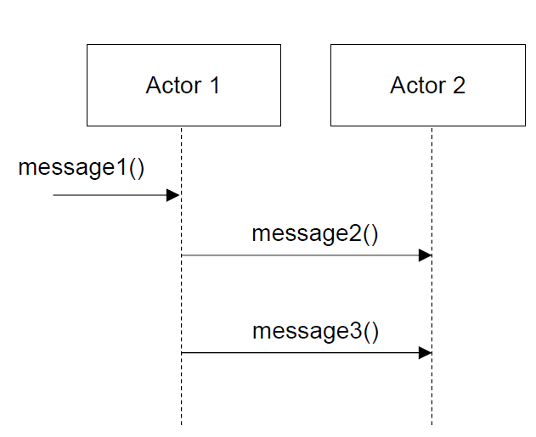
UML Sequence diagrams
Notes:
Sequence diagrams illustrate interactions in a kind of fence format.
● Vertical lifelines represent the ordering of messages
● messages are directed from a sender to a receiver
● make it clear “who is doing what” (and when)

Slide 8
Why Draw an SSD
An interesting question in software design:
What events are coming into our system?
Because we must design the software to handle these events (from the mouse, keyboard, another system, ...) and execute a response
Notes:
Basically, a software system reacts to three things: 1) external events from actors (humans or computers), 2) timer events, and 3) faults or exceptions (which are often from external sources)

Slide 9
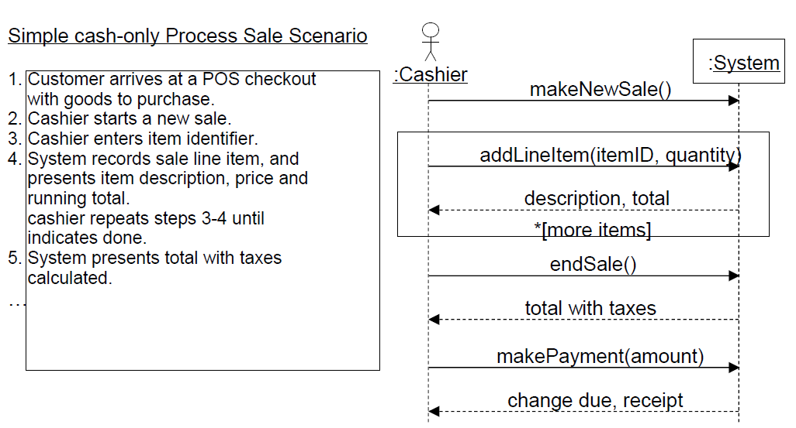
System sequence diagram (SSD)
External actor to sys.
System as a black box
UML loop
A message with params.
Return values
Notes:
An SSD shows, for a particular course of events within a use case, the external actors that interact directly with the system, the system (as a black box), and the system events that the actors generate .
Time proceeds downward, and the ordering of events should follow their order in the scenario
The “:” imply an instance.

Slide 10
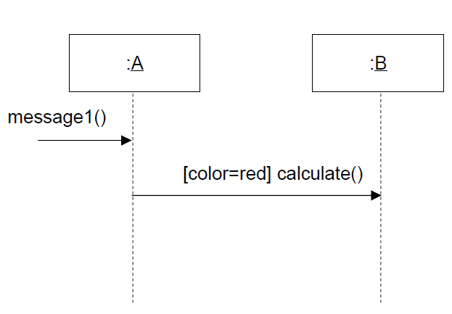
Conditional Messages
Notes:
A conditional message is shown by following a sequence number with a conditional clause in square brackets, similar to the iteration clause.
● The message is sent only if the clause evaluates to true.

Slide 11
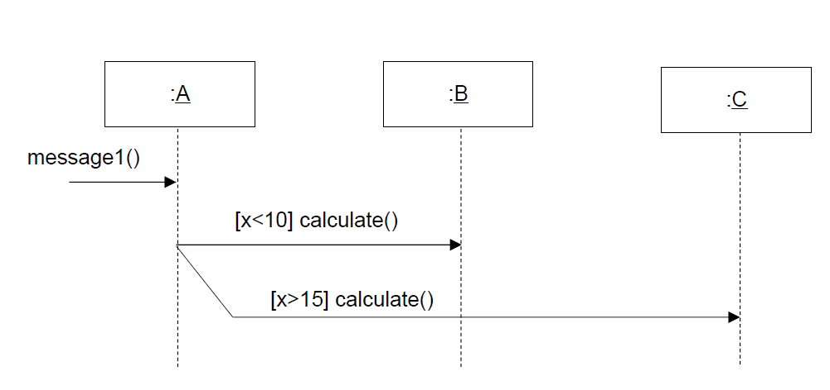
Mutually Exclusive Conditional Messages

Slide 12
When to use (system) sequence diagrams
Supplement (not replace!) textual use case
Drawn for one particular scenario
Show the behavior (collaborations) of several actors within a single use case
If you need to show how a single object behaves across several use cases, use state machine diagrams!
Usually created in later UP phases (Elaboration)

Slide 13
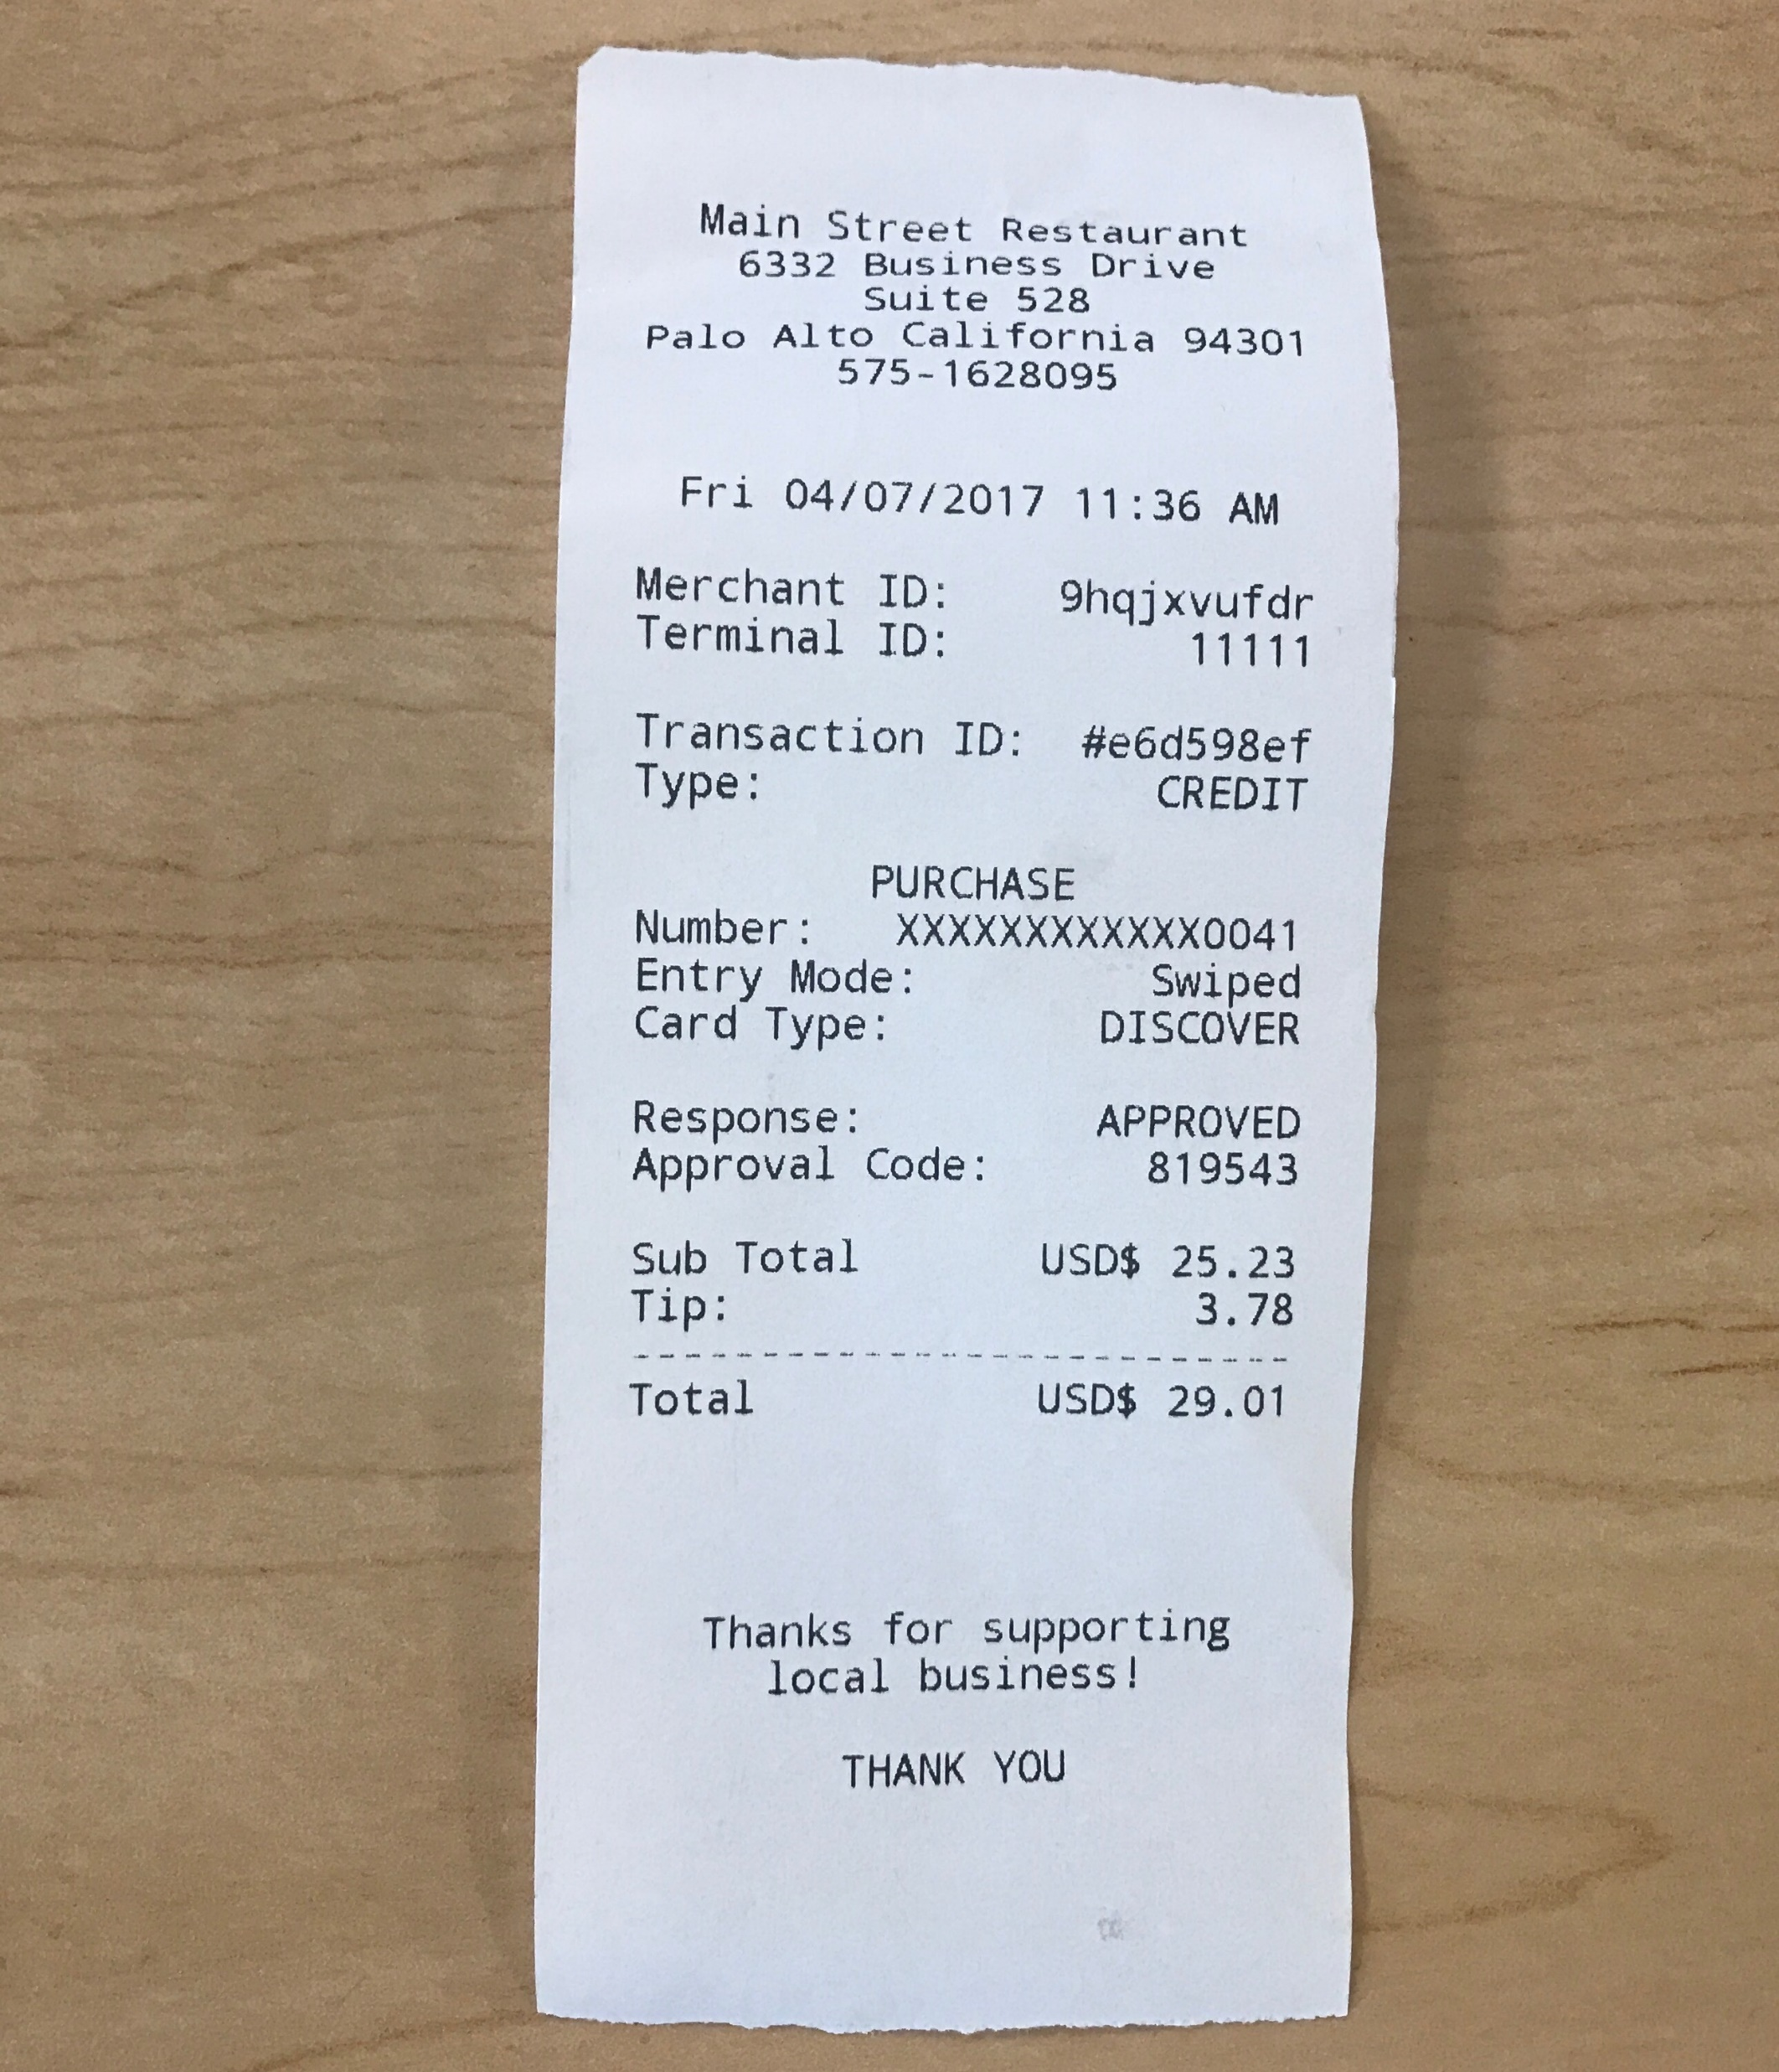
What SDD information to place in the glossary
The elements shown in SSDs (operation name, parameters, return data) are terse
These may need proper explanation so that during design it is clear what is coming in and going out.
The Glossary is a great place for these details
Notes:
For example, in Figure 10.2, there is a return line containing the description "change due, receipt." That's a vague description about the receipt complex report. So, the UP Glossary can have a receipt entry, that shows sample receipts (perhaps a digital picture), and detailed contents and layout.

Slide 14
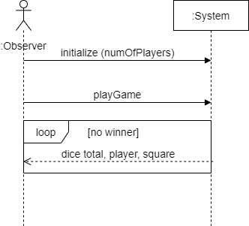
Example 2: Monopoly SSD
Notes:
The Play Monopoly Game use case is simple, as is the main scenario. The observing person initializes with the number of players, and then requests the simulation of play, watching a trace of the output until there is a winner.

Slide 15
SSDs Within the UP
SSDs are part of the Use-Case Model visualization of the interactions implied in the scenarios of use cases
UP encourages the inclusion of all artifacts and practices that add value
Don't create SSDs for all scenarios, unless you are using an estimation technique (such as function point counting) that requires identification of all system operations
SSDs are also very useful when you want to understand the interface and collaborations of existing systems, or to document the architecture

Slide 16
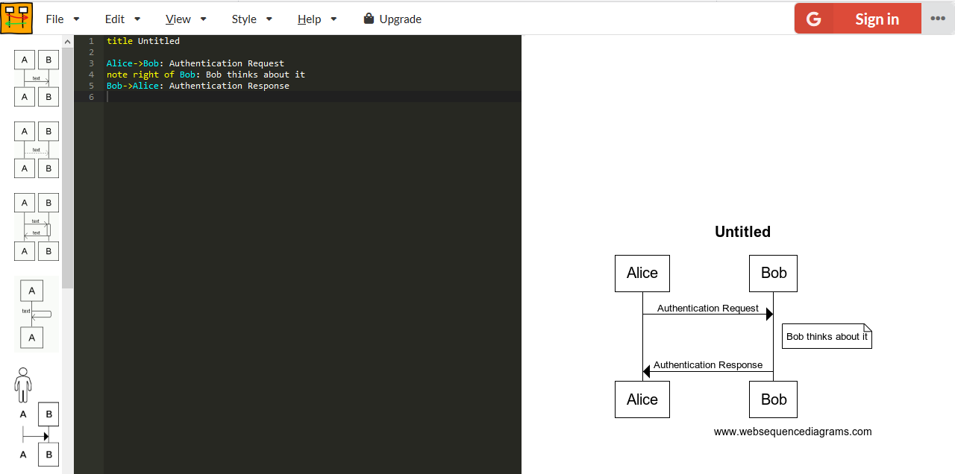
Tools for web sequence diagrams
Web sequence diagrams
https://www.websequencediagrams.com/
Scruffy (python based)
https://github.com/aivarsk/scruffy
PlantUml
https://plantuml.com/
Web sequence diagrams

Slide 17
Activity diagrams

Slide 18
UML Activity Diagrams and Use Cases
Used to naturally represent flows of events in (all) scenarios of a Use Case
A specialization of a state diagram where all states are action states
Enables a representation of branching, repetition and process forking
The key difference between use case diagram and activity diagram is that the use case diagram helps to model the system and user interactions while the activity diagram helps to model the workflow of the system.

Slide 19
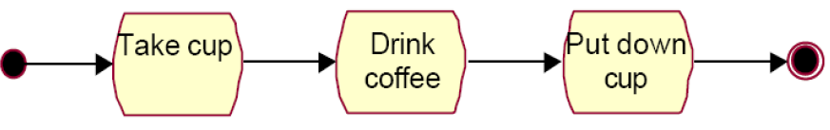
Activity Diagram
Activity diagrams show sequential and parallel activities in a process
Similar to (good old?) flowcharts, Petri nets (used in web service modeling)
Visualize the flow of events in a use case

Slide 20
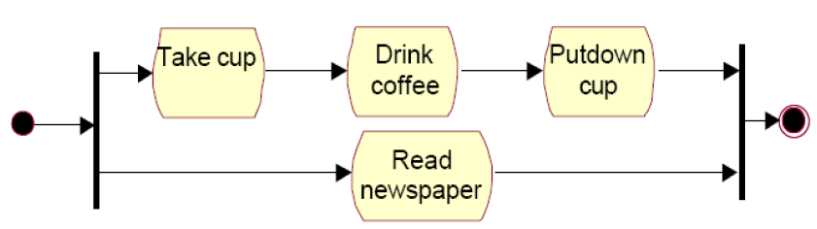
Parallel activities

Slide 21
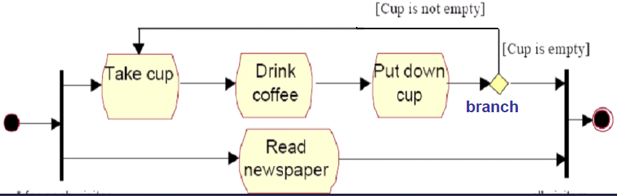
Conditionals

Slide 22
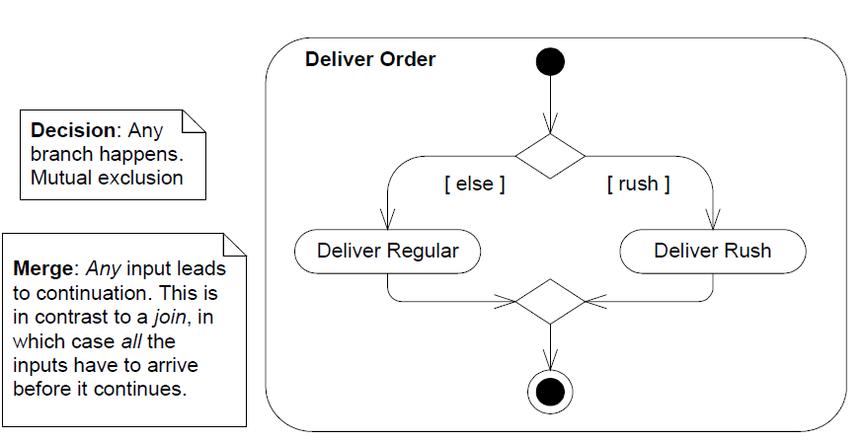
Branch and Merge
Notes:
A merge event brings together multiple flows that are not concurrent.

Slide 23
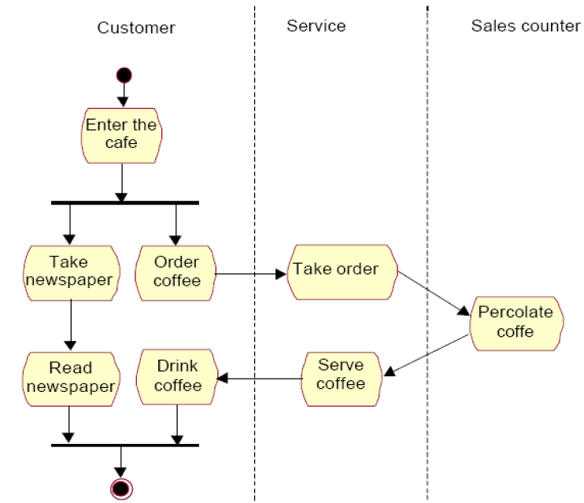
Activity diagrams: Swim lanes (partitions)
Notes:
Partitions often correspond to organizational units or business actors in a business model.
Activity partition may be shown using a swimlane notation - with two, usually parallel lines, either horizontal or vertical, and a name labeling the partition in a box at one end
Any activity nodes, e.g. actions and edges placed between these lines are contained within the partition.

Slide 24
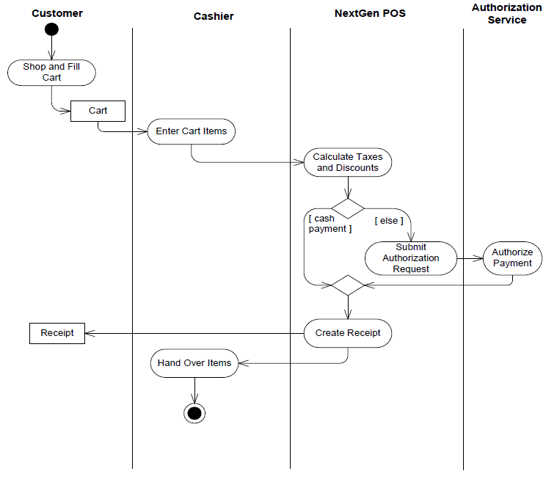
Swim lanes: POS Example

Slide 25
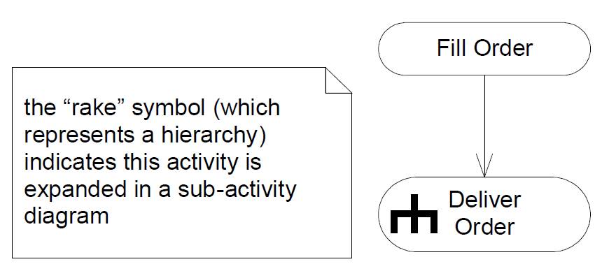
Sub-activities: Modeling complex workflows
Notes:
To model sub-activities (an activity expanded into another activity diagram), use the rake symbol

Slide 26
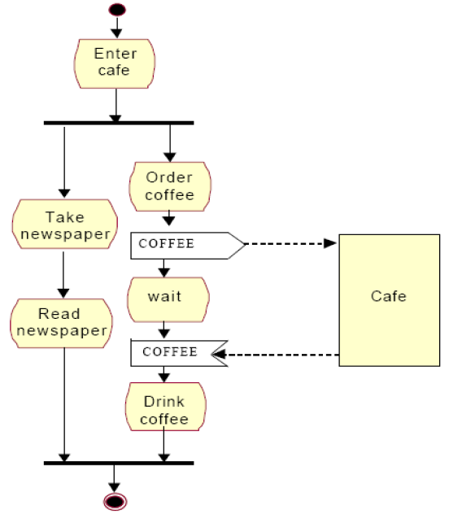
Signals
Notes:
Signals represent how activities can be modified from outside the system. They usually appear in pairs of sent and received signals, because the state can't change until a response is received, much like synchronous messages in a sequence diagram. For example, we need that the barista brews our coffee before we can have sip . Or in an authorization of payment is needed before an order can be completed.

Slide 27
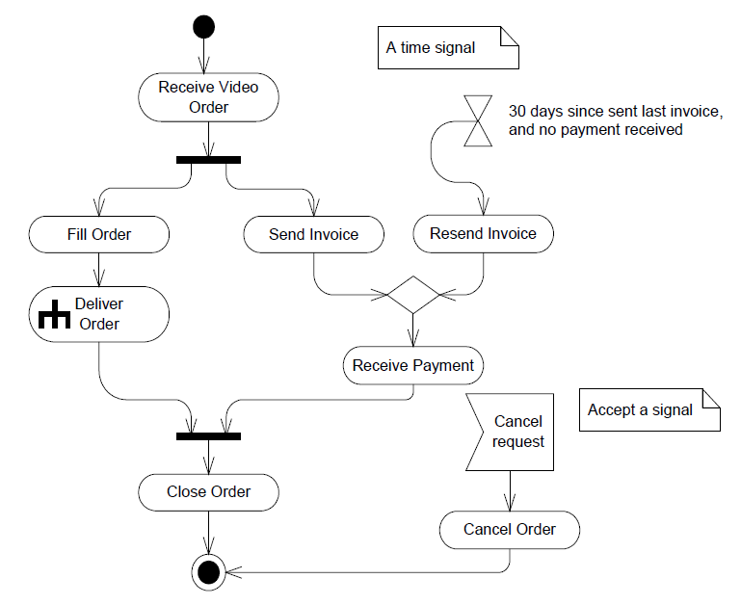
Time signals
Notes:
This refers to an event that stops the flow for a time; an hourglass depicts it.

Slide 28
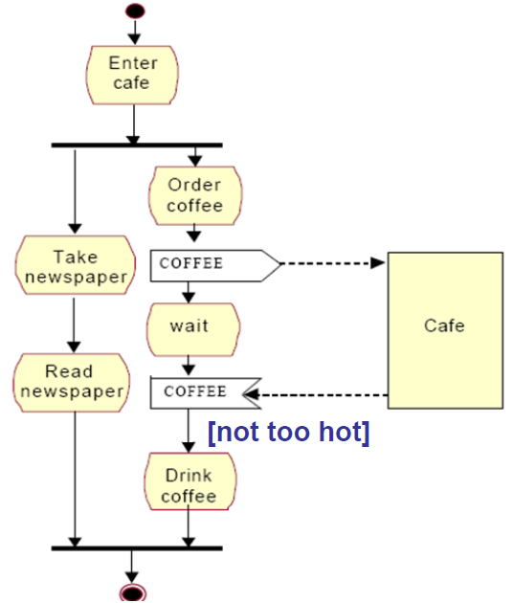
Guard conditions
Notes:
Accept event action could have incoming edges. In this case the action starts after the previous action completes.
The guard of the activity edge is shown in square brackets that contain the guard. The guard must evaluate to true for every token that is offered to pass along the edge.

Slide 29
Activity diagram summary
Activity diagrams focus on
What tasks need to be done?
With what inputs?
In what order?
They do not focus on
Who or what is doing the task. You can use swim lanes to indicate that (as in sequence diagrams)

Slide 30
When to use activity diagrams
Complex use cases with many alternative flows or extensions can become difficult to understand
Parallelism is not easily conveyed in natural language
Can be used for both control flow modeling and data flow modeling

Slide 31
Activity diagram guidelines
Quality assurance
Use activity diagrams for complex processes
Stay within one level of abstraction
Make use of the “rake symbol” to keep the diagram readable
Use it to enhance use case text descriptions, not the other way round
If you create one, remember it must be kept up-to-date (traceability!)

Slide 32
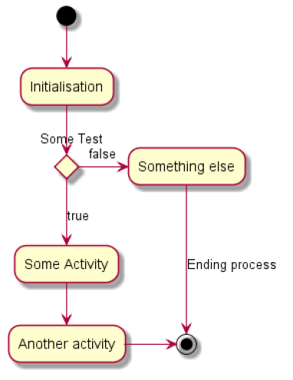
Tool support: PlantUML
@startuml
(*) --> "Initialisation"
if "Some Test" then
-->[true] "Some Activity"
--> "Another activity"
-right-> (*)
else
->[false] "Something else"
-->[Ending process] (*)
endif
@enduml

Slide 33
UML State machine diagrams

Slide 34
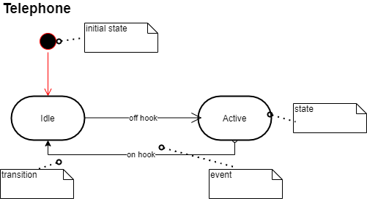
State machine diagram for a telephone
Notes:
A UML state machine diagram illustrates the interesting events and states of an object, and the behavior of an object in reaction to an event. Transitions are shown as arrows, labeled with their event. States are shown in rounded rectangles. It is common to include an initial pseudo-state, which automatically transitions to another state when the instance is created.

Slide 35
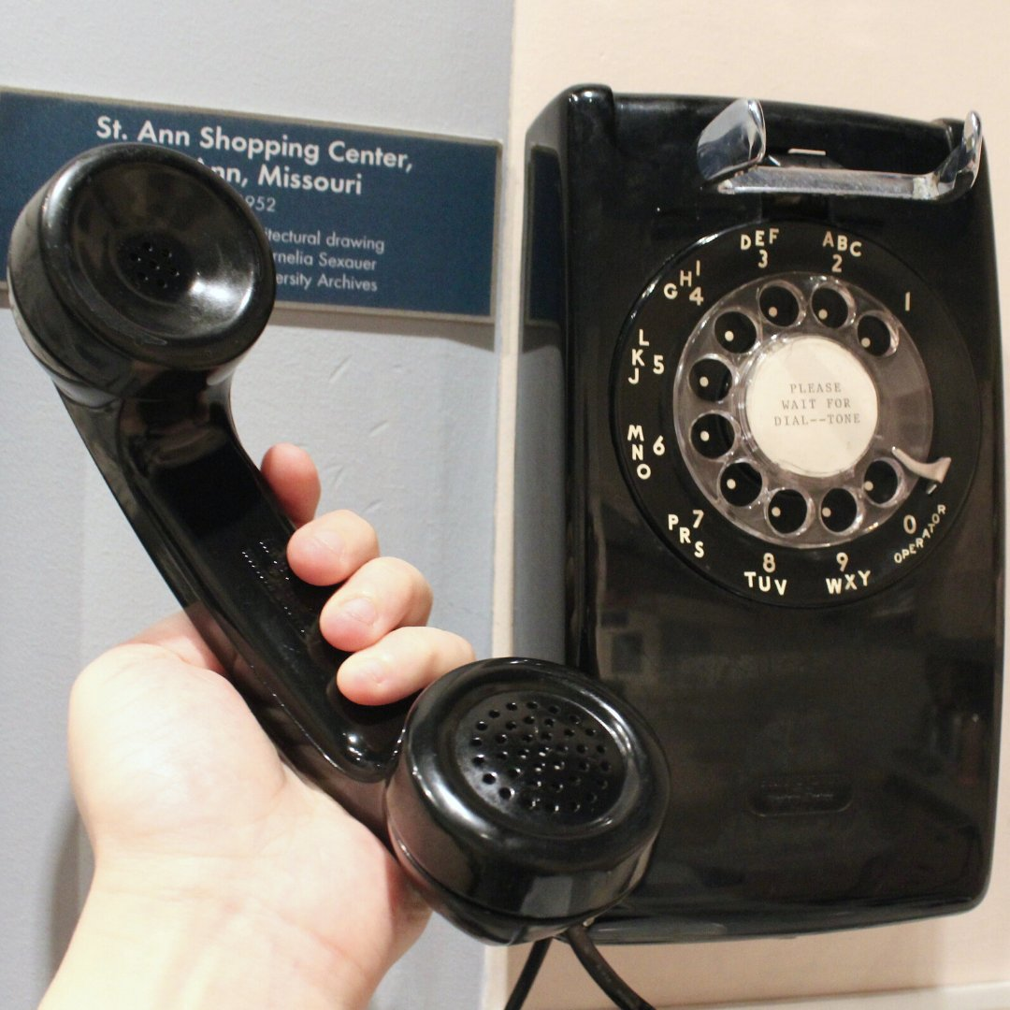
Definitions: events, states, and transitions
An event is a significant or noteworthy occurrence
A state is the condition of an object at a moment in time time between events
A transition is a relationship between two states that indicates that when an event occurs, the object moves from the prior state to the subsequent state
Notes:
An event is a significant or noteworthy occurrence
For example: A telephone receiver is taken off the hook
A state is the condition of an object at a moment in time between events
For example: A telephone is in the state of being "idle" after the receiver is placed on the hook and until itis taken off the hook
A transition is a relationship between two states that indicates that when an event occurs, the object moves from the prior state to the subsequent state
For example: When the event "off hook" occurs, transition the telephone from the "idle" to "active" state

Slide 36
How to Apply State Machine Diagrams
State-Independent and State-Dependent Objects
If an object always responds the same way to an event, then it is considered state-independent (or modeless) with respect to that event
By contrast, state-dependent objects react differently to events depending on their state or mode
Consider state machines for state-dependent objects with complex behavior, not for state-independent objects
Notes:
If an object always responds the same way to an event, then it is considered state-independent(or modeless) with respect to that event. For example, if an object receives a message, and the responding method always does the same thing. The object is state-independent with respect to that message. If, for all events of interest, an object always reacts the same way, it is a state-independent object. By contrast, state-dependent objects react differently to events depending on their state or mode
For example, a telephone is very state-dependent. The phone's reaction to pushing a particular button (generating an event) depends on the current mode of the phone off hook, engaged, in a configuration subsystem, and so forth

Slide 37

Guideline
In general, business information systems have few complex state-dependent classes
By contrast, process control, device control, protocol handlers, and telecommunication domains often have many state-dependent objects. If you work in these domains, definitely know and consider state machine modeling

Slide 38

Application of state machine diagrams
Physical Devices controlled by software
Transactions and related Business Objects
Role Mutators
Communication Protocols
UI Page/Window Flow or Navigation
UI Flow Controllers or Sessions
Notes:
Physical Devices controlled by software. Phone, car, microwave oven: They have complex and rich reactions to events, and the reaction depends upon their current mode.
Transactions and related Business Objects. How does a business object (a sale, order, payment) react to an event? For example, what should happen to an Order if a cancel event occurs? And understanding all the events and states that a Package can go through in the shipping business can help with design, validation, and process improvement.
A Person changing roles from being a civilian to a veteran. Each role is represented by a state.
TCP, and new protocols, can be easily and clearly understood with a state machine diagram. The diagram illustrates when operations are legal. For example, a TCP "close“ request should be ignored if the protocol handler is already in the "closed" state
UI Page/Window Flow or Navigation When doing UI modeling, it can be useful to understand the legal sequence between Web pages or windows; this is often complex. A state machine is a great tool to model UI navigation
UI Flow Controllers or Sessions This is related to UI navigation modeling, but specifically focused on the server-side object that controls page flow. These are usually server-side objects representing an ongoing session or conversations with a client. For example, a Web application that remembers the state of the session with a Web client and controls the transitions to new Web pages, or the modified display of the current Web page, based upon the state of the session and the next operation that is received.

Slide 39

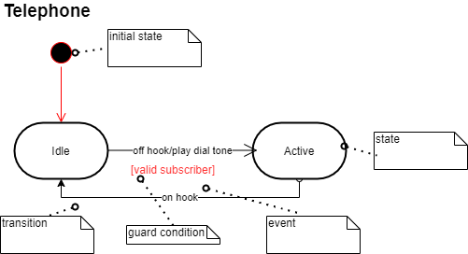
Transition Actions and Guards
Notes:
A transition can cause an action to fire. In a software implementation, this may represent the invocation of a method of the class of the state machine diagram. A transition may also have a conditional guard or boolean test. The transition only occurs if the test passes.

Slide 40
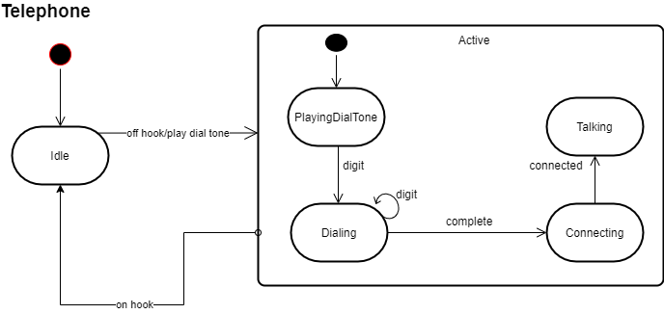
Nested States
Notes:
A state allows nesting to contain substates; a substate inherits the transitions of its superstate (the enclosing state). Substates may be graphically shown by nesting them in a superstate box.
For example, when a transition to the Active state occurs, creation and transition into the PlayingDialTone substate occurs. No matter what substate the object is in, if the on hook event related to the Active superstate occurs, a transition to the Idle state occurs.

Slide 41
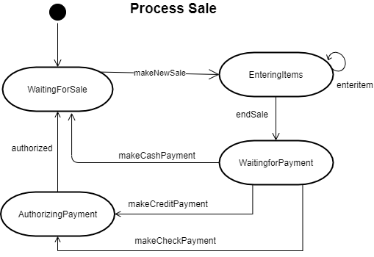
Example: Process Sale use case

Slide 42
State machine in the UP
There is not one model in the UP called “state model”
Rather, any element in any model (Design model, domain model, business object model, etc.) may have a state machine
The purpose is to better understand or communicate its dynamic behavior in response to events

Slide 43
Conclusion
Sequence diagrams and activity diagrams provide a graphical notation that can enhance a textual specification (e.g., based on use cases)
System sequence diagrams (SSDs) model the system as a black box and focus on the events generated by actors and how they are handled by the system
Activity diagrams are data/control flow graphs. They can enhance textual use cases descriptions by modeling all extensions and alternative scenarios in a single diagram
State machine diagrams allow you to explicitly model how a system reacts to external or internal events, including temporal events. This kind of modeling is particularly well suited for designing systems where processing of an event depends on the current state of an object – as opposed to systems, where objects always react in the same way to an event

Slide 44
References
Martin Fowler. UML Distilled: A Brief Guide to the Standard Object Modeling Language. Addison-Wesley, 3rd edition, 2004.
Craig Larman. Applying UML and Patterns. Prentice Hall, third edition, 2005.
UML Activity Diagrams Reference. https://www.uml-diagrams.org/activity-diagrams-reference.html
UML activity diagrams. https://www.smartdraw.com/activity-diagram/

